Slide 1
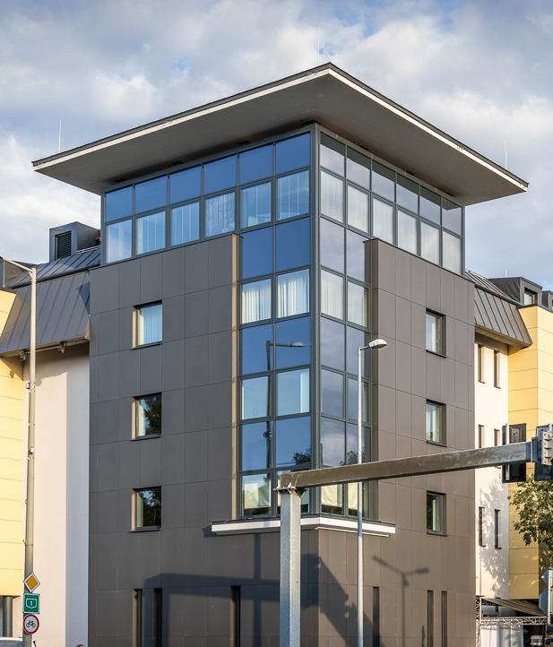
Working Conference #2, Győr
Overview project pitches
held on ELEVATEcee Working Conference #2 in Györ
03 rd June 2026
www.ELEVATEcee.eu

Slide 2

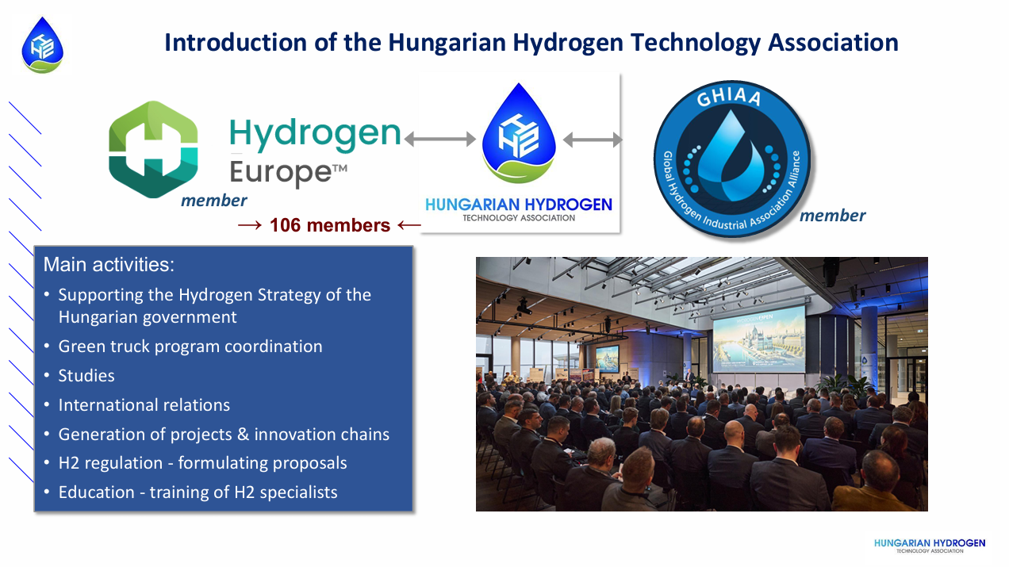

Slide 3
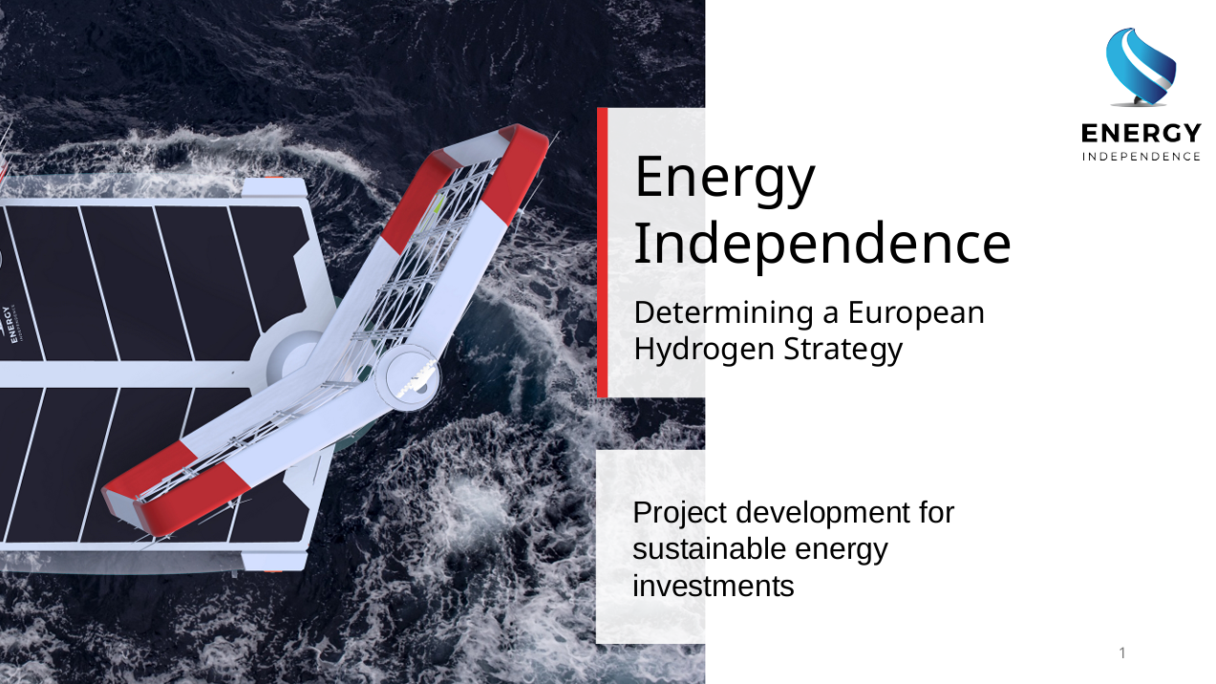

Slide 4


Slide 5
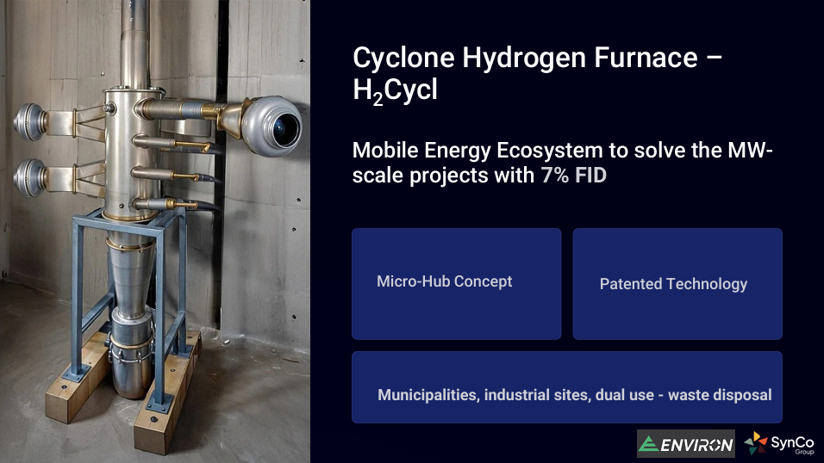

Slide 6


Slide 7


Slide 8


Slide 9


Slide 10


